Slide 1
Group 3
Shumaiya Karim 1330056043
Md. Sayem Mahmud 1611231042
Aaquib Javed 1611205042
Zahir Mohammad Mishaal 1520082043
COVID-19 GPS TRACKING SYSTEM APPLICATION BASED ON ANDROID

Slide 2
Problem Domain
Requirements
Users need
Features like functional requirements
Analysis
Research on features
Efficiency
Solution Domain
Design
Model Design
UI design
Implementation
Features implementation according to model

Slide 3
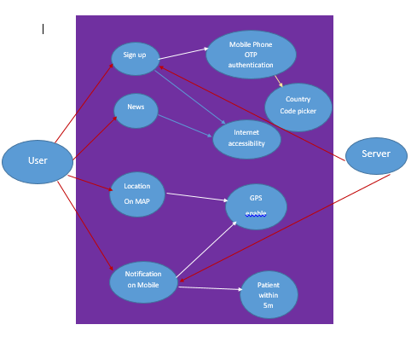
Diagram

Slide 4
Work Progress
Splash Screen
Sign Up/Log in
Mobile Phone Verification OTP(Using Firebase)
Location Tracking
Dashboard UI
Navigation Drawer
About APP
Personal Data Retrieve
Total COVID patient detection on given range.
Mobile alert for user whom are close to Covid positive user.

Slide 5
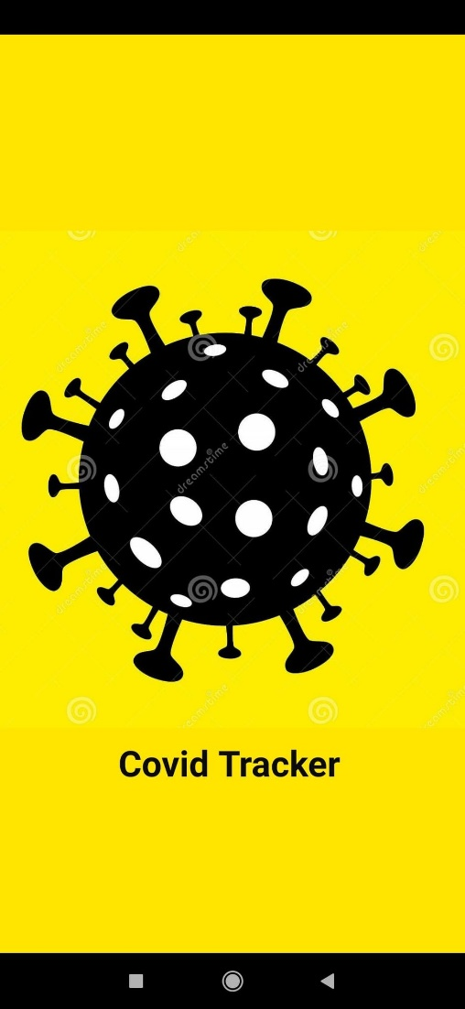
Splash Screen
A Splash Screen THAT IS DISPLAYED FOR 5 seconds

Slide 6
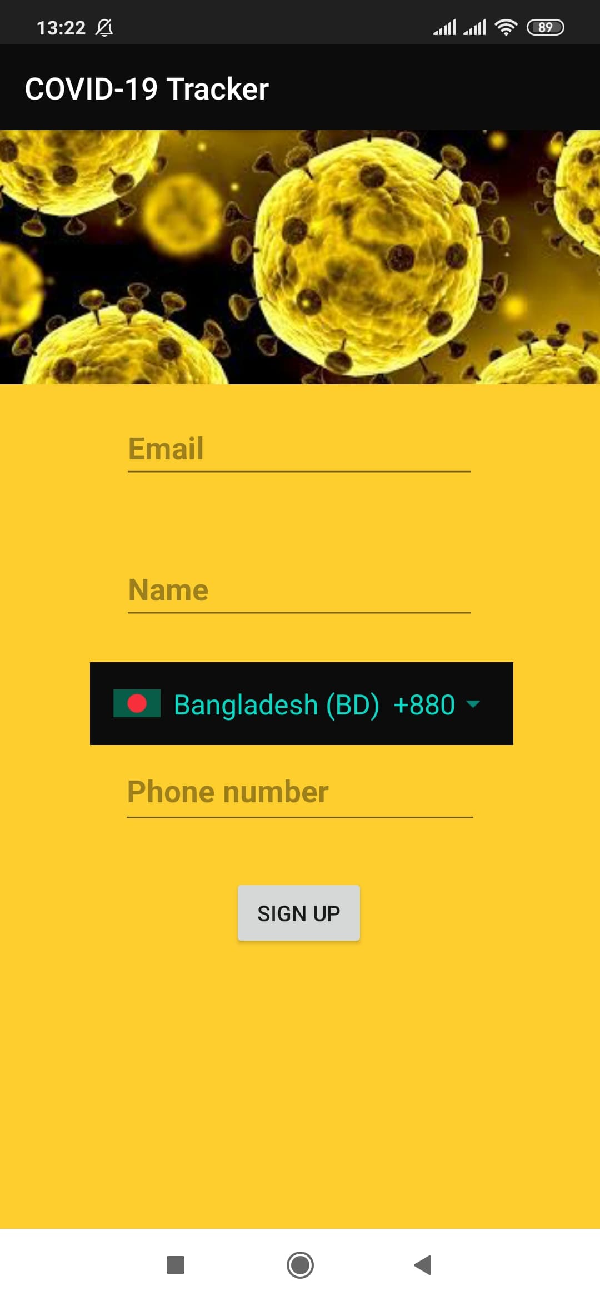
SIGN UP
Use of a Country Code Picker
App connected to a Firebase database

Slide 7
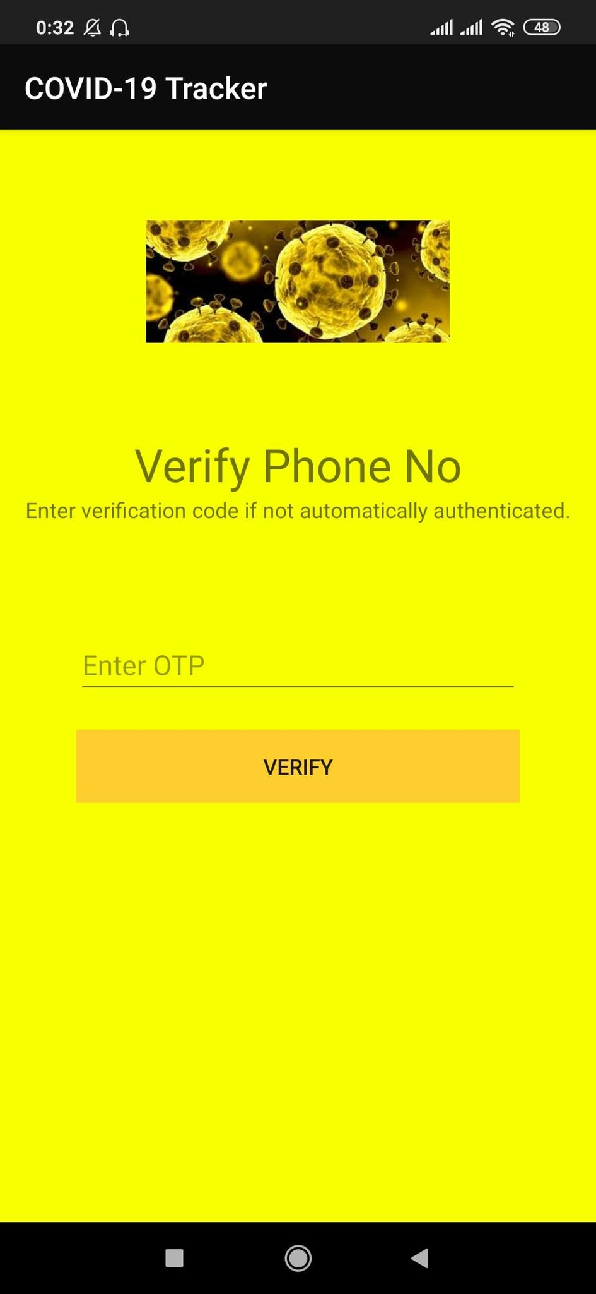
Phone Verification
Auto code fetching on same device mobile.
Saving on Firebase.
After verifying code goes into Dashboard.

Slide 8
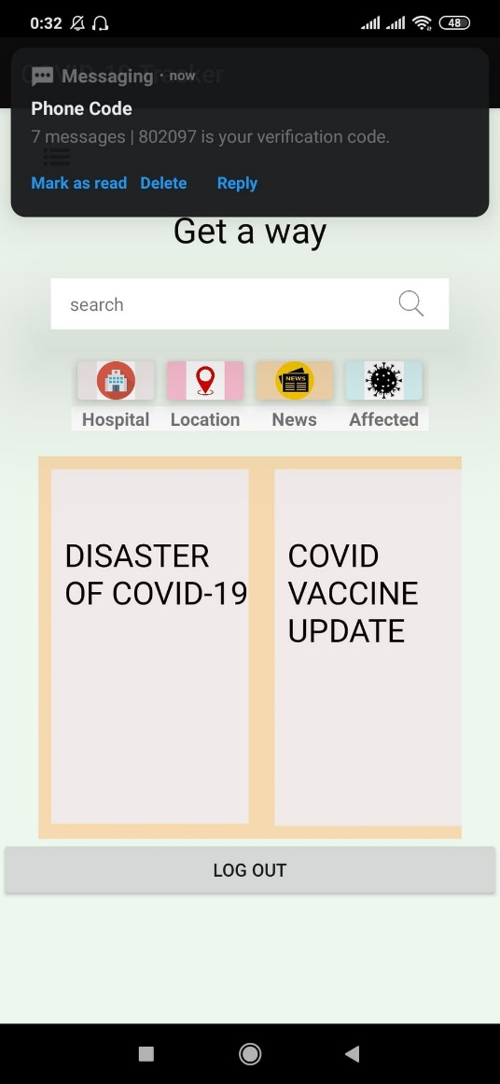
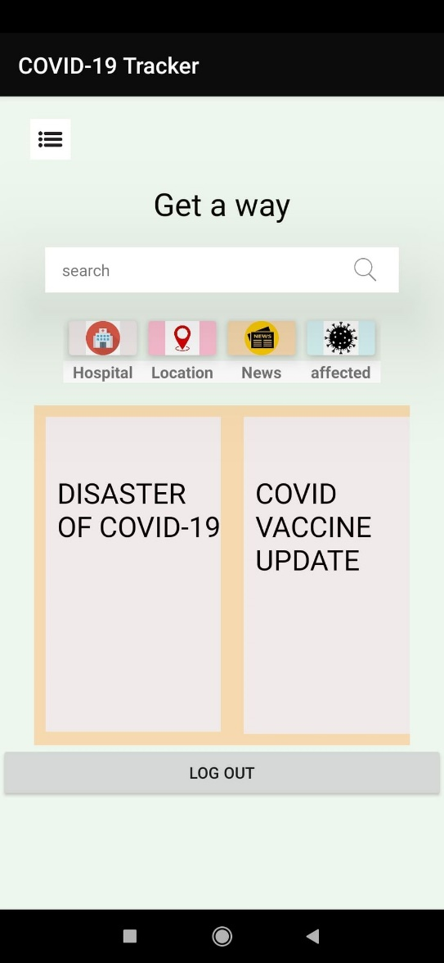
Dashboard
Menu icon opens the navigation bar.
Search bar to bring COVID related news in one place.
Search for hospital details, infected in the user’s current location, COVID related news, total affected rate over the world.

Slide 9
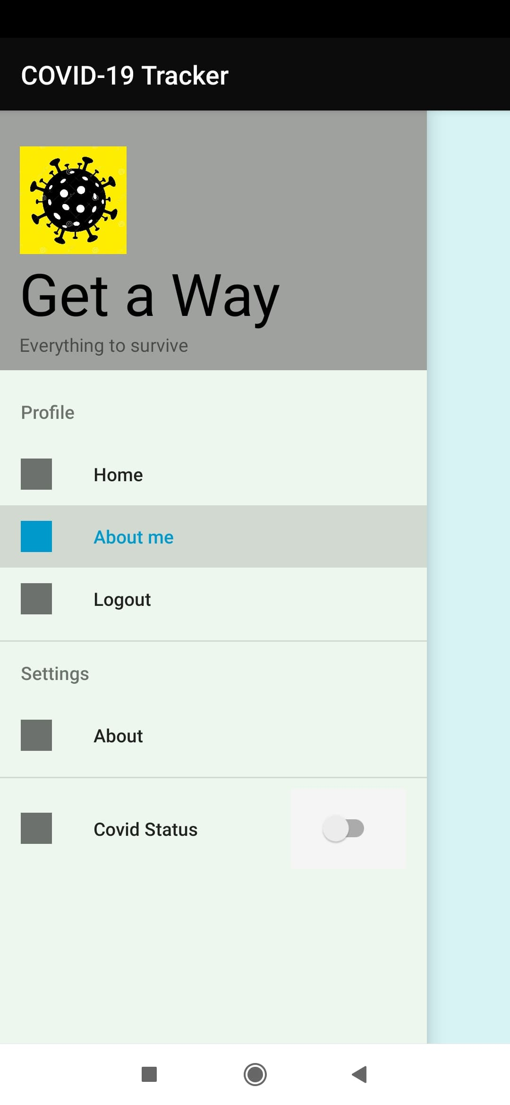
Navigation Drawer
Home – Redirect to Dashboard.
About me -- Retrieve user information form server.
Logout – Logout from server and redirect to signup page.
About – Overview of the Application.
COVID Status – Users can mark them COVID positive/Negative.

Slide 10
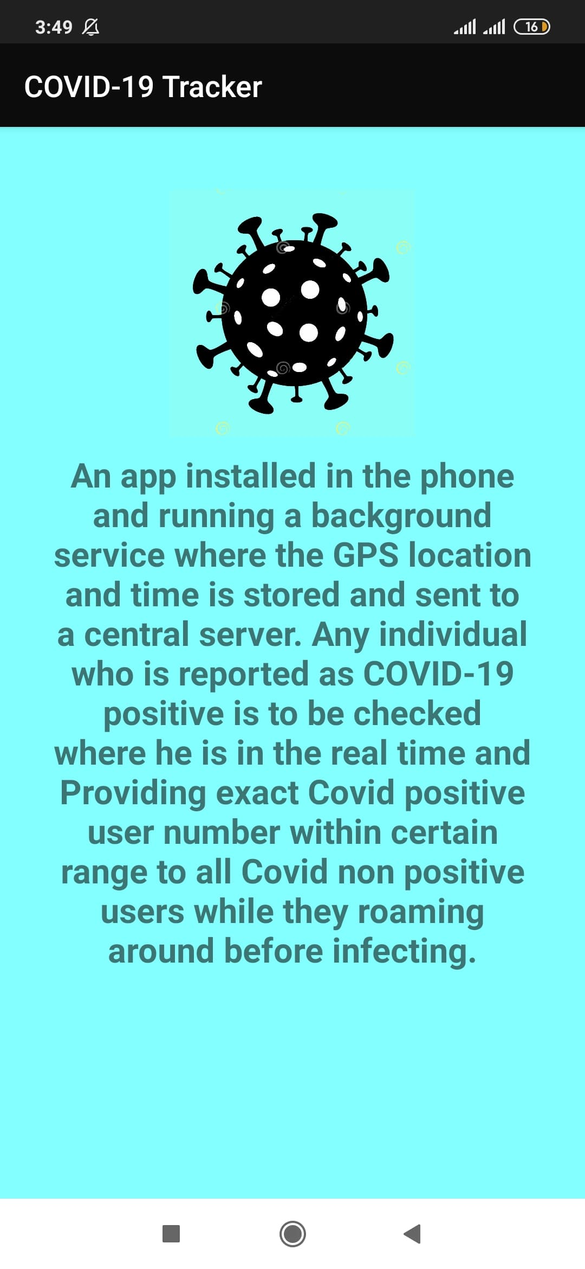
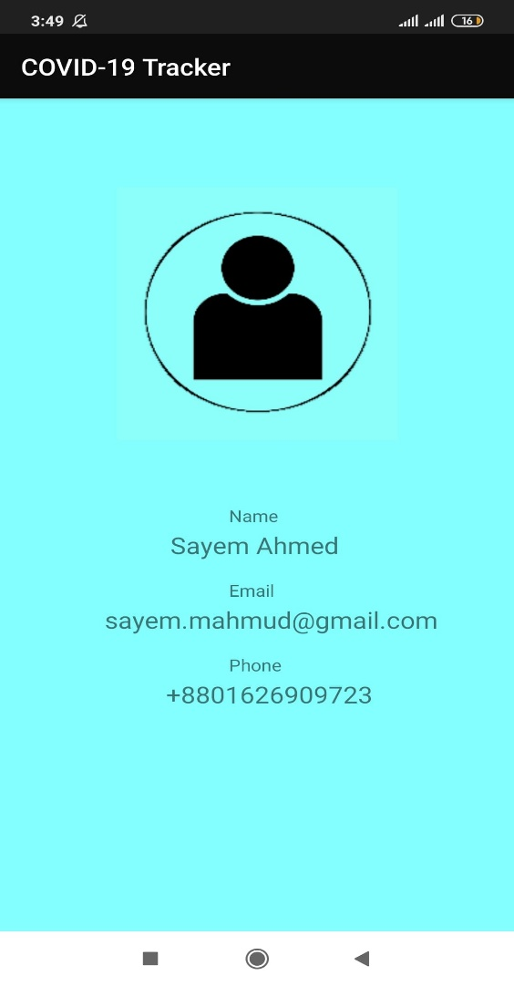
About APP
ABOUT ME

Slide 11
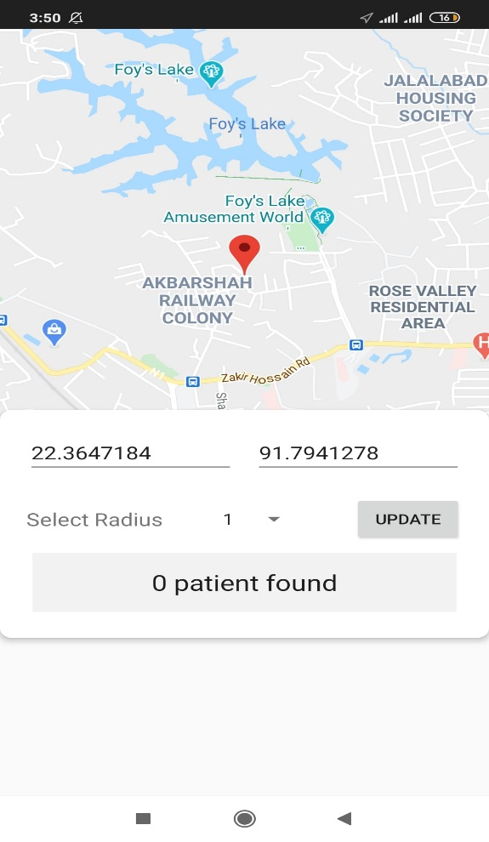
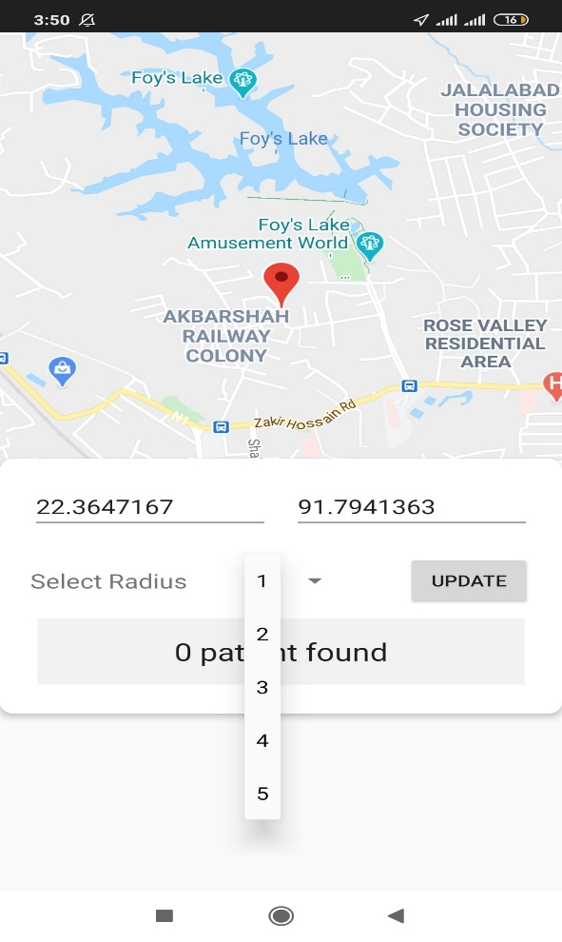
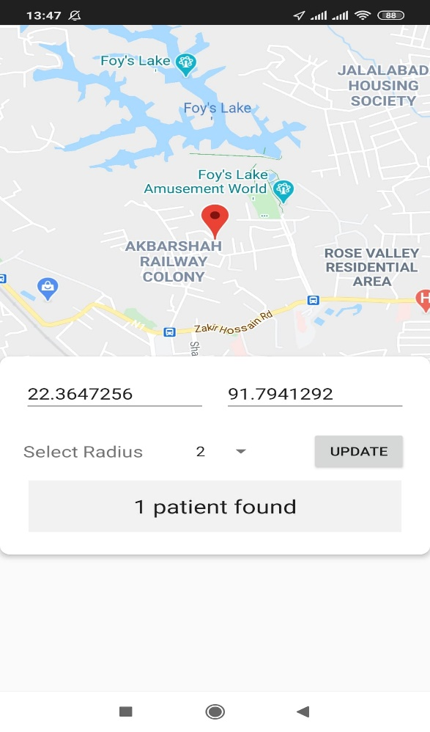
Location Tracking
Current location showing on MAP (Accessibility by GOOGLE API).
Location(LAN, LOT) updating on server 2 seconds seconds after and after.
Detecting COVID status positive user from server within given range.
Here shown that no one found affected within 1km but for 2 km someone exists .

Slide 12
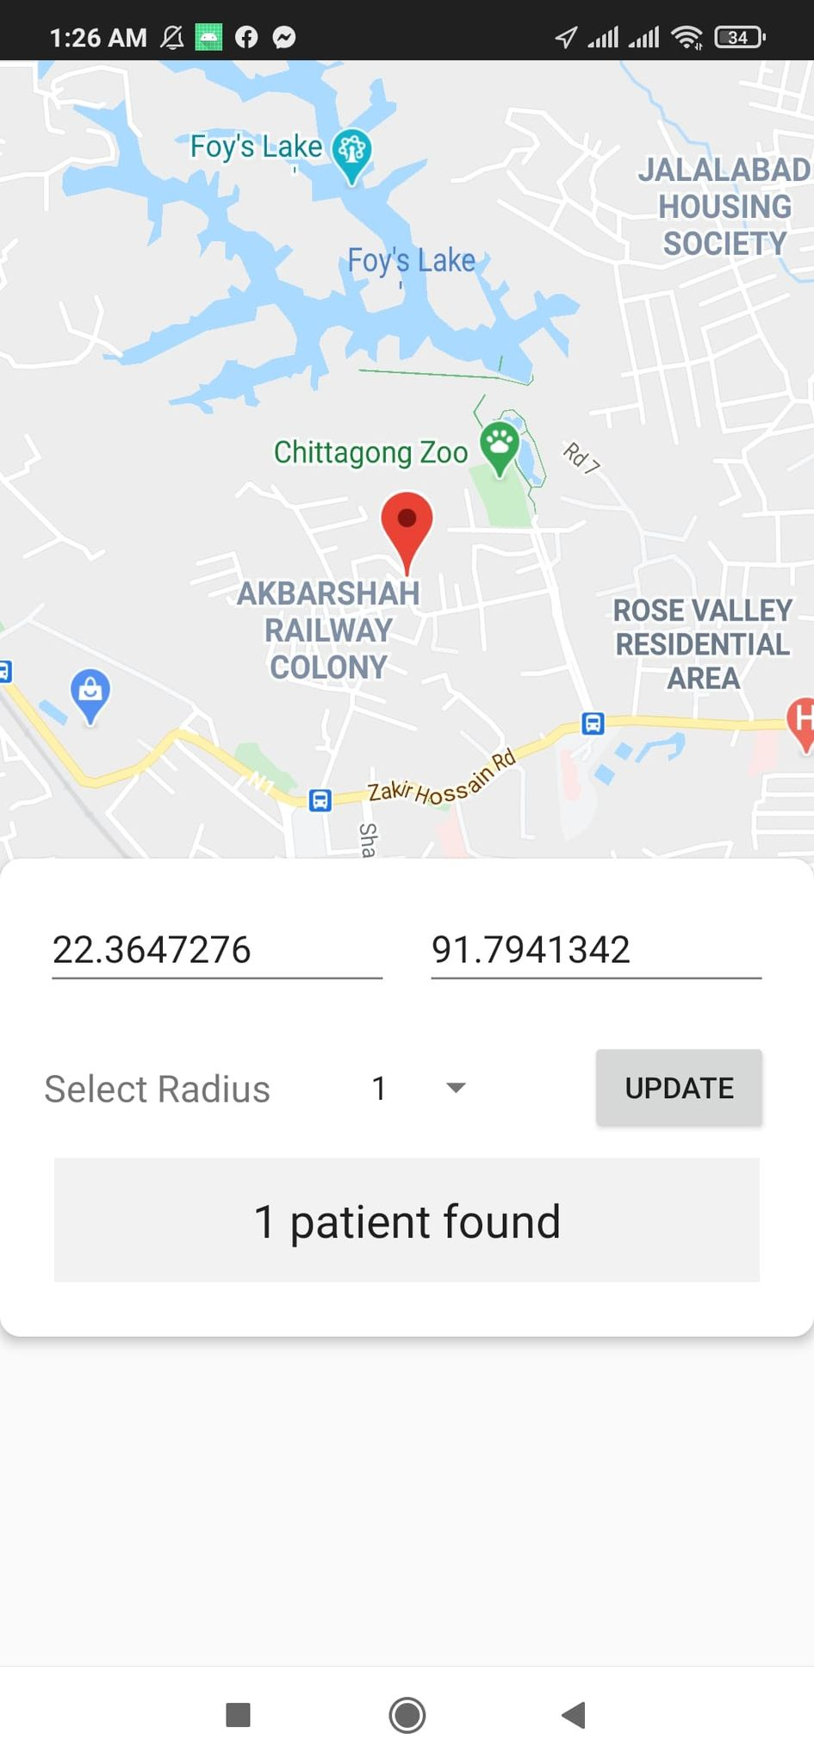
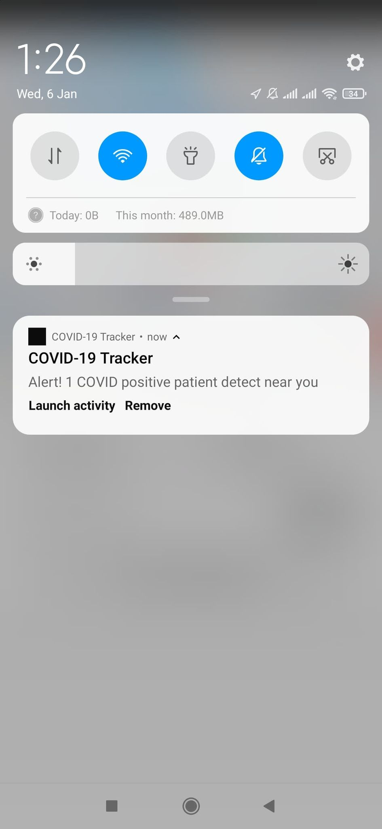
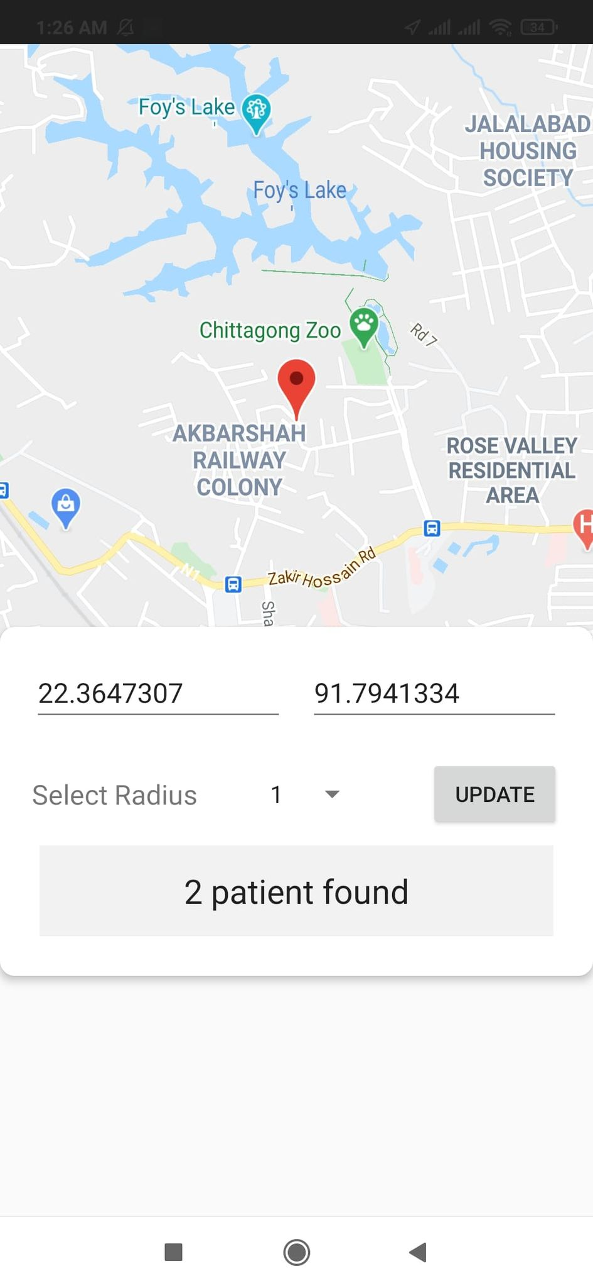
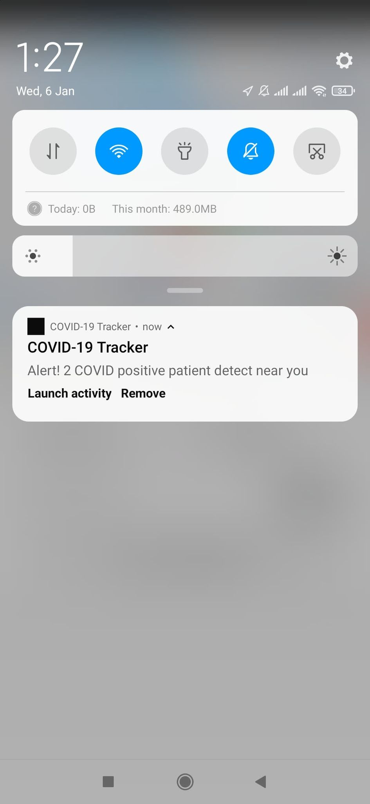
Mobile Alert
Here is the mobile alert sample while affected people within 5m range of a user established by a notification channel while affected people within 5m range of a user.

Slide 13
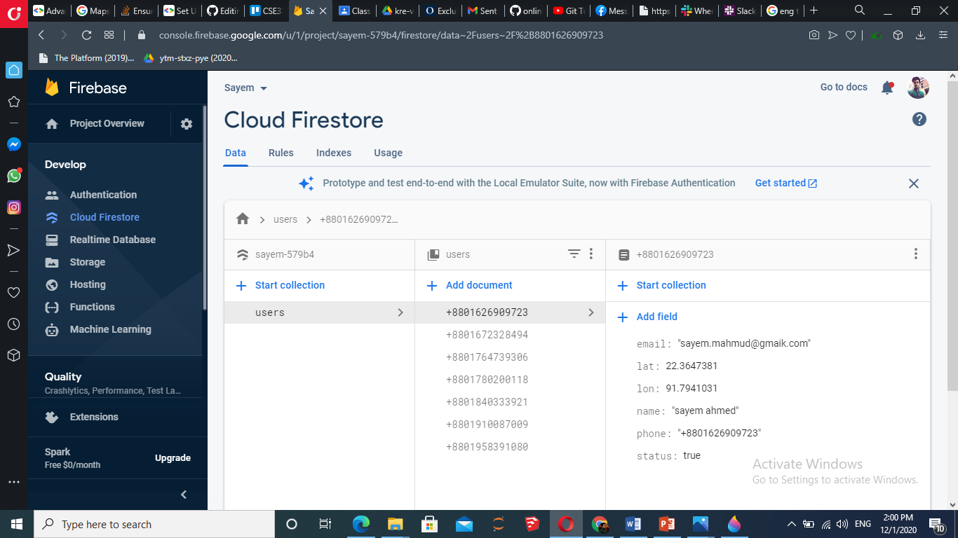
FIREBASE DataBase
Using Cloud Firestore for realtime data synchronization.
Updating time limitation is 2 seconds as fast first a bluetooth.

Slide 14
WHY TO USE this Application?
Ease of access
A more transparent Data record
Self awareness and protection
Swifter response when vaccine is available

Slide 15
How it can be more successful in Bangladesh?

Slide 16
Thank you

